Slide 1
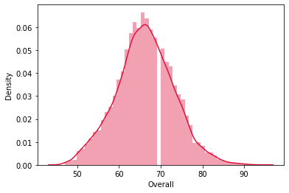
EDA – Key Highlights from Data set
Majority of the players have a Overall rating of ~60 – 70 in the data set.
Players having a rating of >85 can be considered as world-class players and they are highly valued and relatively rare.
The Overall Rating column is normally distributed and positive trends are found for value-wage and value-release clause columns.

Slide 2
Contract Insights
Players whose contract are expiring this year(2020) are also shown. These players can potentially be bought for comparatively lesser price as they don’t have much time left in their contracts and it puts their parent club at a weaker leveraging position.
These players have a average wage of ~50k and their average age is ~25
Some of these players can be really useful as they have >75 ratings which can help a club to fight for wins.
We also see a correlation between rating and value, which we can use while bidding for these players to potentially be able to buy them for competitive prices.

Slide 3
Top Players
The top players in the world have overall rating of 90+ and they all play for European Football Clubs.
Majority of them 90+ rated players are under 30 in age and chances are they could still improve their game.
They rake in the highest wages and their values are also the highest in the game.
Since they are the best, their release clause in their contracts also have high values so as to discourage other clubs from trying to woo them.
These Players are Messi, C.Ronaldo, Neymar, De Gea, K.De Bruyne.
Only 1 Goal Keeper makes the list of Top 5 Players.

Slide 4
Wages Insights
As we can see there is a correlation between position and wage.
Modern Football is very physical and it’s not surprising to see the Strikers, LW,RW get paid the most as they are most responsible for goals scored.
Possession is very important as well, hence, CM’s, CDM’s and CAM’s are next highly paid as well as they are responsible in creating the chances for the strikers and wingers.
Modern Defenders are beasts as they take on the best strikers and stop them from scoring goals, so CB’s are also highly paid.
A goal keeper is the one saving the striker’s shots so they are also handsomely paid.

